Slide 1
Care and Maintenance of Portable Meters
2017 Meter Technician Training School
Steven Sievert
Manager, Quality Certification Services Inc.
Technical Director, National DHIA
Chair, ICAR Subcommittee for Recording and Sampling Devices

Slide 2
Topics to Cover…
Maintenance of Approved Meters
Storage and Transport of Meters
Proper Sampling and Reading

Slide 3
Maintenance of Approved Meters

Slide 4
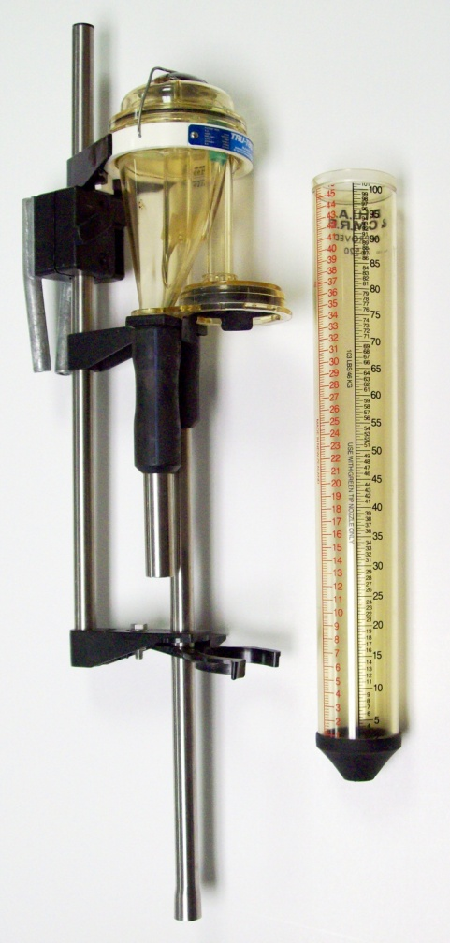
Tru-Test Pull-Out
Most popular meter in Northeast and Midwest
Easy to maintain
Standard Bore (old) or Wide Bore (new) models
Labor intensive operation
Low cost of ownership

Slide 5
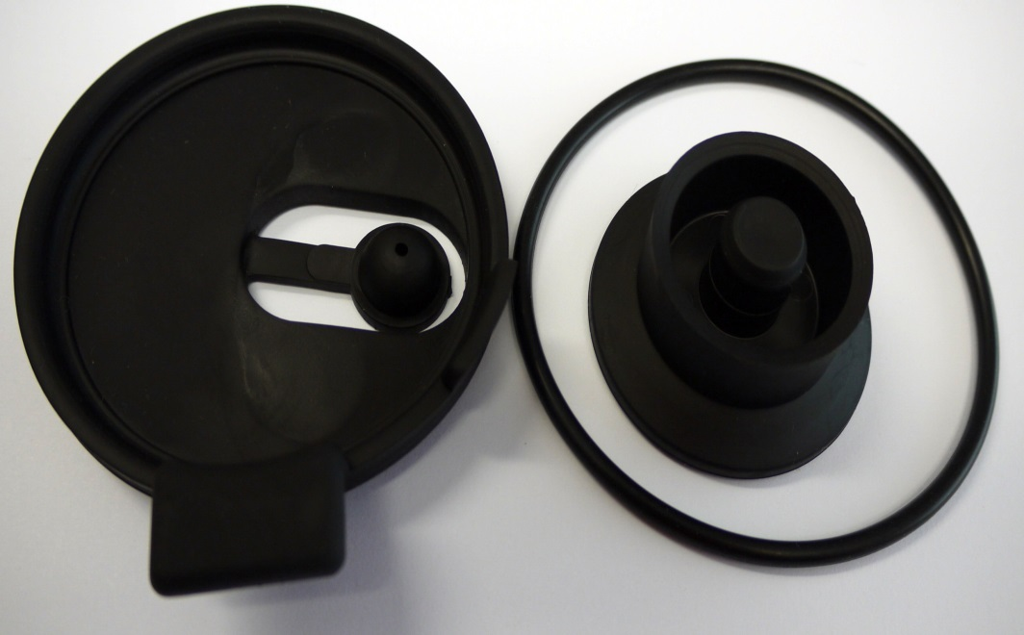
Tru-Test Pull-Out - Maintenance
Replace VSO at least once per year
Replace gasket on cap yearly
Replace the flask plug yearly or when breakdown of rubber is noticeable
2
4
1

Slide 6
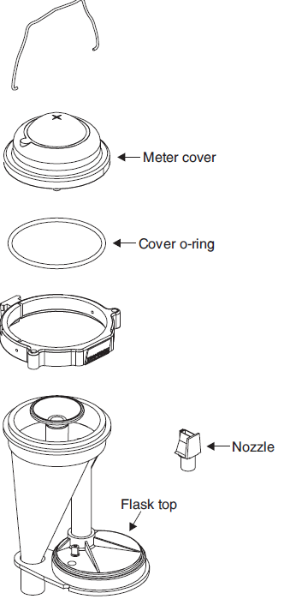
Tru-Test Pull-Out - Maintenance
Inspect nozzle, replace only when meter does not calibrate
Remove with fingers – not pliers, etc.
Do not reuse nozzles

Slide 7
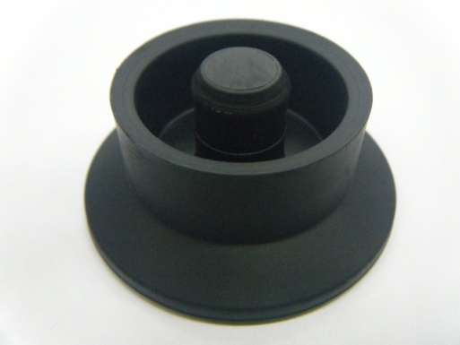
Tru-Test Pull-Out - Maintenance
Flask plug improvements have been made
Thicker base
Tolerances changed to fit & seal better to flask
Look for 3 dot pips under the base for the improved flask plugs

Slide 8
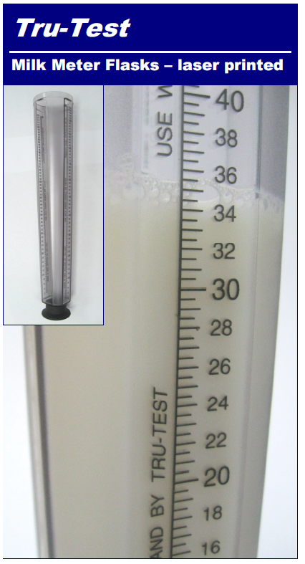
Tru-Test Pull-Out - Maintenance
New laser-etched flasks – do not use flask tapes on flasks for WB meters

Slide 9
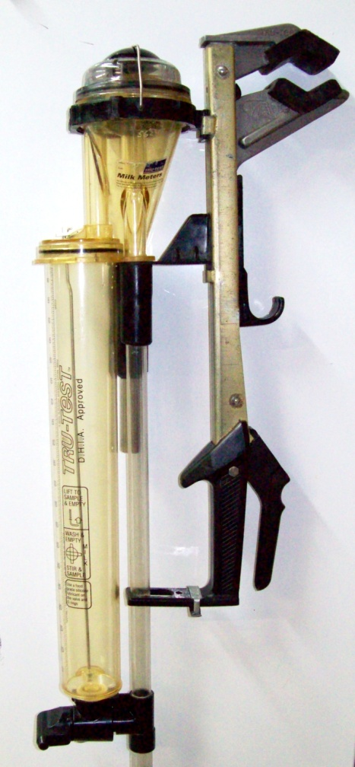
Tru-Test Ezi-Test
Most popular meter in the world
Milk, Wash/Mix and Sample positions
Standard Bore (old) or Wide Bore (new) models
Self-contained (closed system)

Slide 10
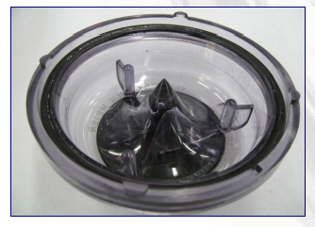
Tru-Test Ezi-Test - Maintenance
Replace gasket on cap yearly
Inspect nozzle, replace only when meter does not calibrate
Remove with fingers – not pliers, etc.
Do not reuse nozzles

Slide 11
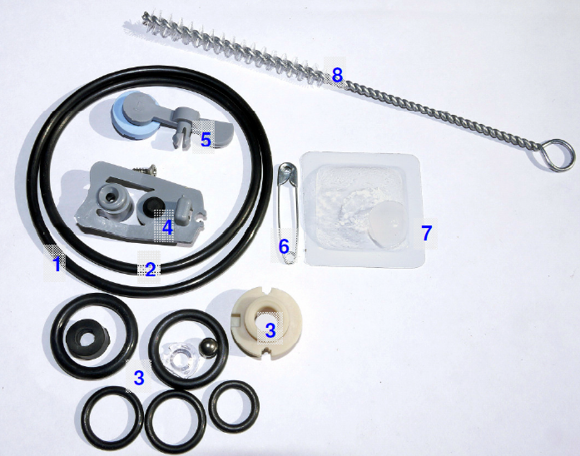
Tru-Test Ezi-Test – Annual Service Kits

Slide 12
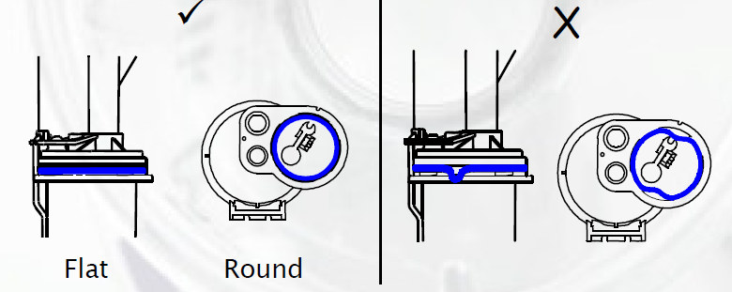
Tru-Test Ezi-Test – Flask Seal
Replace flask seal

Slide 13
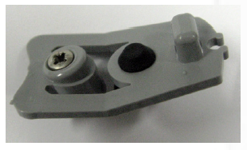
Tru-Test Ezi-Test - Maintenance
Replace rocker and seal assembly
Check and replace air admission valve seal when necessary
Do not over tighten screw

Slide 14
Tru-Test Ezi-Test - Maintenance
Plastic T-Piece
Easily broken
$20+ repair cost
Store with valve in Milk Position

Slide 15
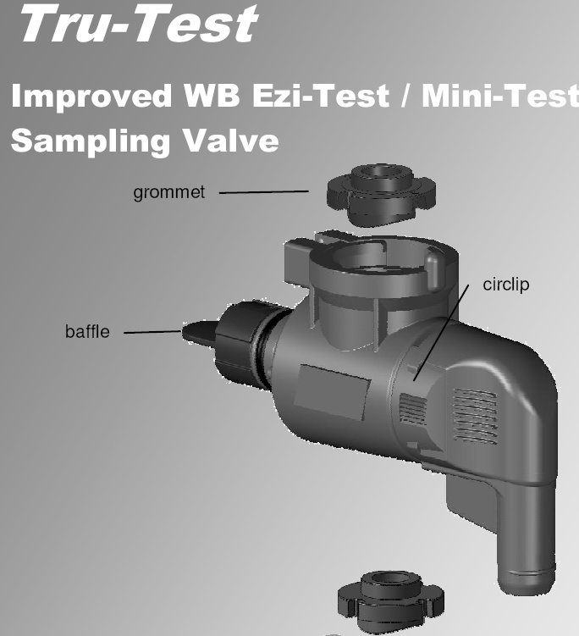
Tru-Test Ezi-Test - Maintenance
Must replace entire valve
Dark charcoal in color
Should reduce broken wash baffle issue

Slide 16
Tru-Test Ezi-Test - Grommets

Slide 17
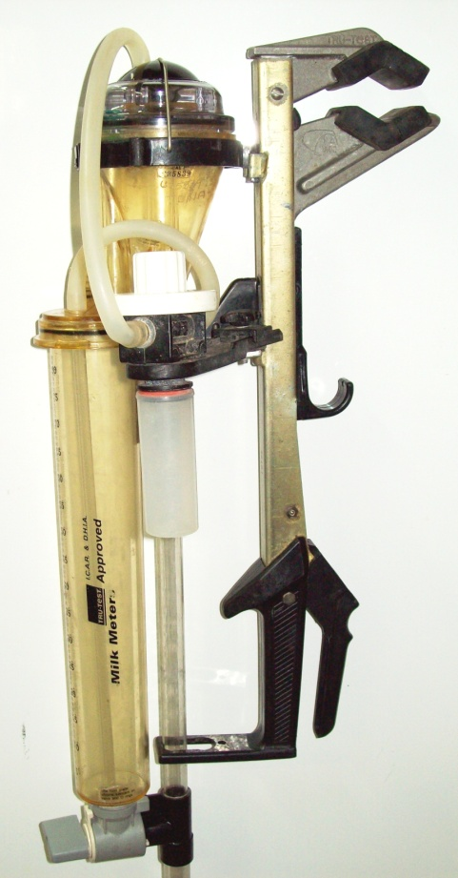
Tru-Test Auto-Sampler
Mixing and sampling with push of button
Labor-efficient
Standard Bore (old) or Wide Bore (new) models
High cost of ownership
Multiple service kits
Cap, sampler, valve and body damage

Slide 18
Tru-Test Auto Sampler - Maintenance
Replace gasket on cap yearly
Inspect nozzle, replace only when meter does not calibrate
Remove with fingers – not pliers, etc.
Do not reuse nozzles

Slide 19
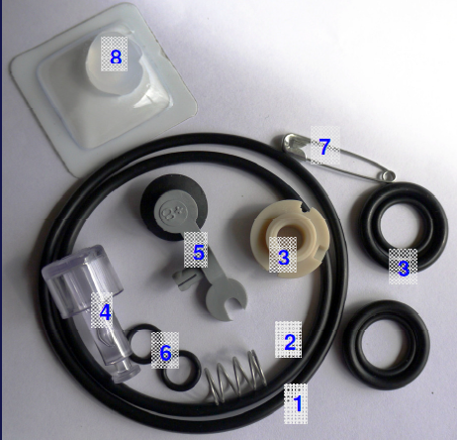
Tru-Test Auto Sampler – Service Kits

Slide 20
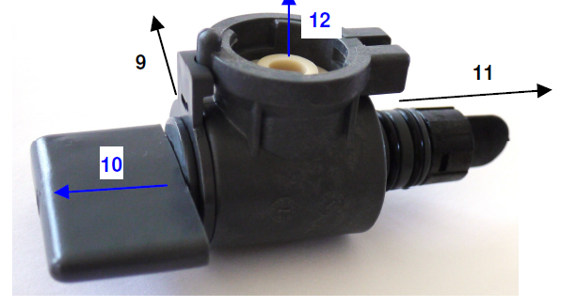
Tru-Test Auto Sampler – Maintenance

Slide 21
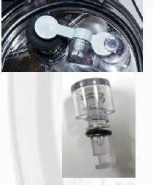
Tru-Test Auto Sampler - Maintenance
Replace rocker and seal assembly
Replace push button and O-ring

Slide 22
Tru-Test Auto Sampler – Flask Seal
Replace flask seal

Slide 23
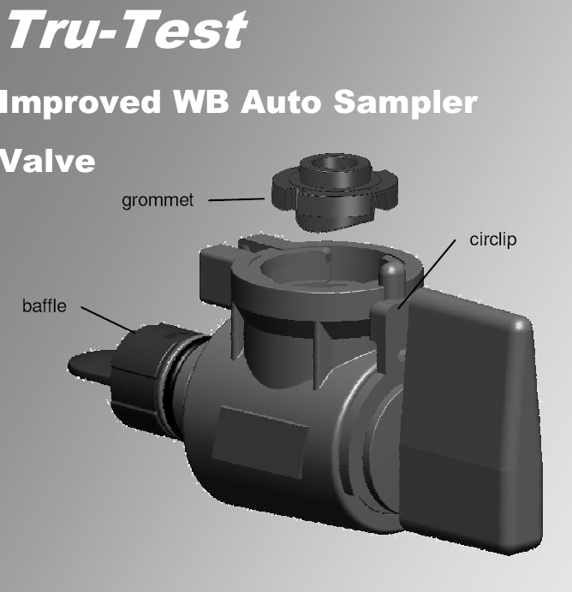
Tru-Test Auto Sampler - Maintenance
Must replace entire valve
Dark charcoal in color
Should reduce broken wash baffle issue

Slide 24
Tru-Test Auto Sampler - Grommets

Slide 25
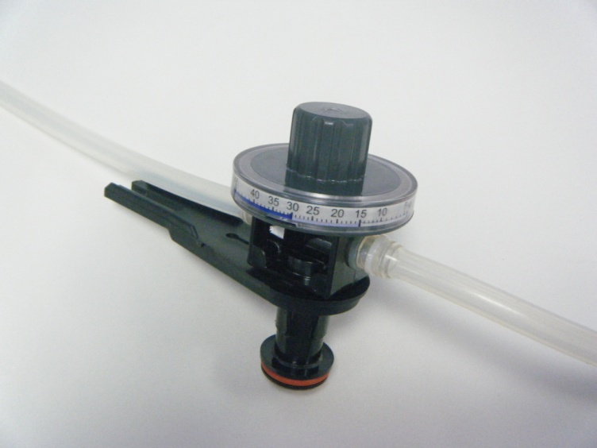
Tru-Test Auto-Sampler – Sampler Dial
New Calibration Label
Weight Levels
Zones – Low/Med/High
New Ring
Snap Fit
Dark Grey in Color

Slide 26
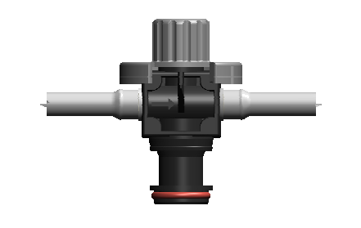
Tru-Test Auto-Sampler – Sampler
Replace O-ring on Sampler

Slide 27
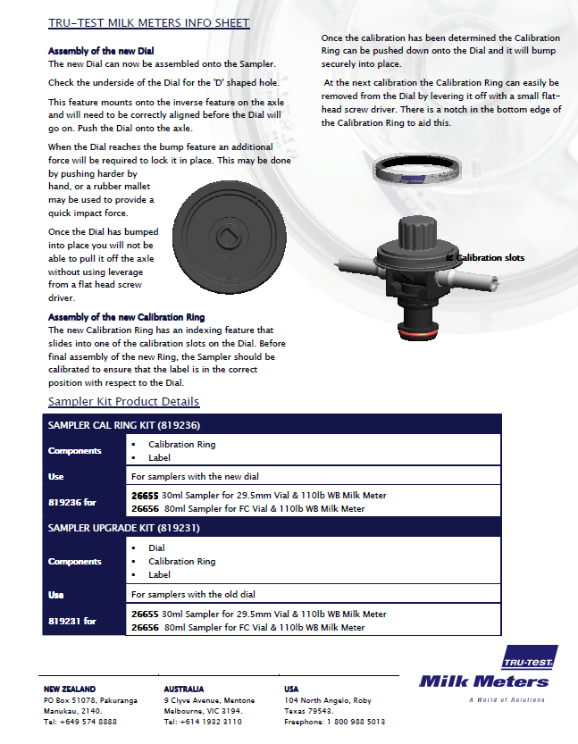

Slide 28
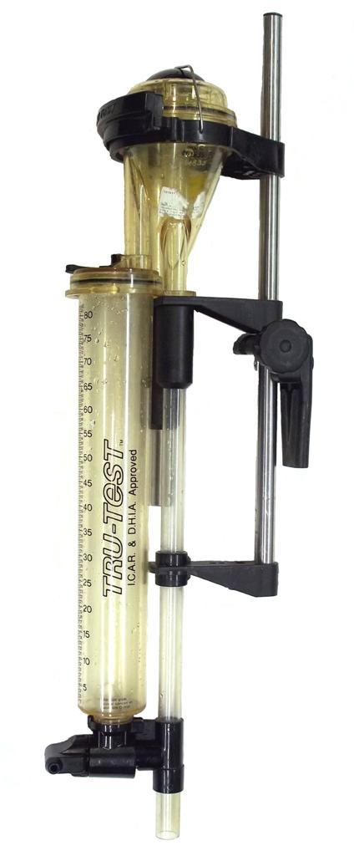
Tru-Test Farmer and Econo-Valve
Only Standard Bore models
Over 30 years old
No parts available
Dated image of DHI
Still approved but should be removed from service?

Slide 29
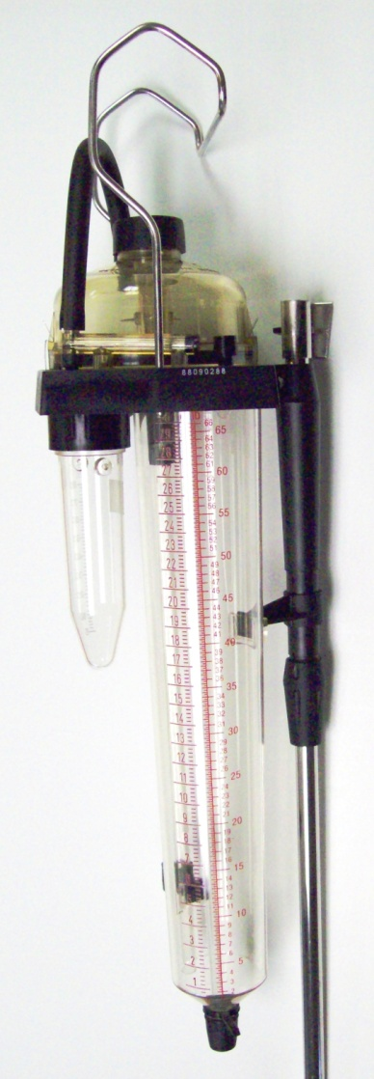
Foss Milko-Scope
Volumetric Meter
No longer manufactured but DeLaval owns patent
Reliable and accurate
Durable except for bracket
Larger vacuum drop
Larger dome
Small inlet (similar to SB)

Slide 30
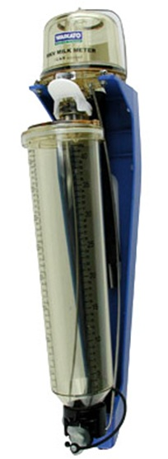
Waikato MK V
Same mode of operation as Ezi-Test
Annual Service Kit
Don’t forget to replace inlet hoses
Durable
Larger vacuum drop
Larger dome
More prevalent in large parlors

Slide 31
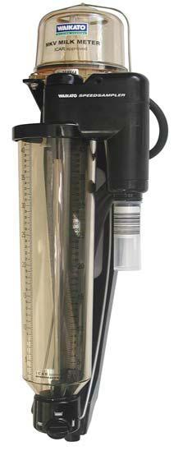
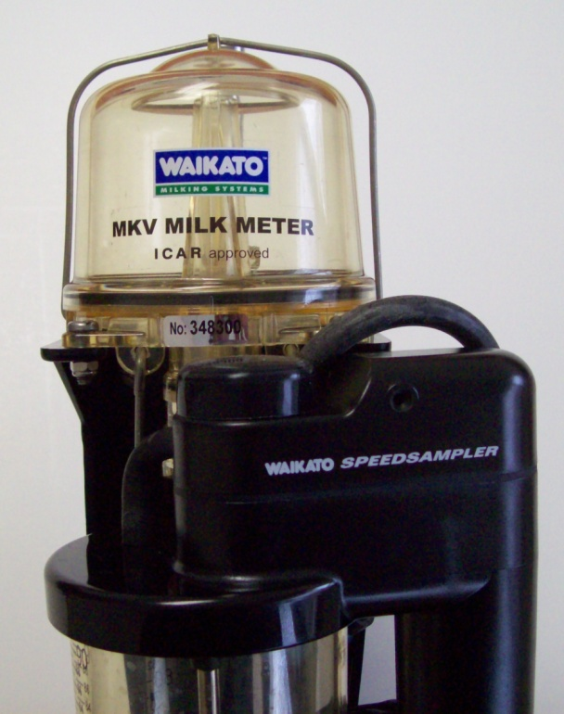
Waikato SpeedSampler
Annual Service Kit
Sampler Service Kit
Don’t forget to replace inlet hoses
Check all hoses for cracks or leaks
Check bungs for wear and ensure lifter arm is properly positioned

Slide 32
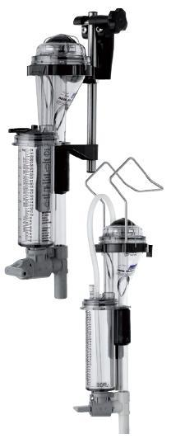
Unapproved DHI Meters – Mini-Test
Not ICAR Approved
Weighing and sampling accuracy does not meet tolerances
Farmer Use only
SCC checks between test days
Does not matter what test plan – cannot use for DHI

Slide 33
Unapproved DHI Meters - TeSa
Never ICAR Approved
Weight principle – not volumetric principle
No parts available
National DHIA/QCS acceptance expired on December 31, 2010

Slide 34
Unapproved DHI Meters - Bodmin
Never ICAR Approved
Significant sampling issues
Milk fat variance as high as 52%
SCC variance as high as 34%

Slide 35
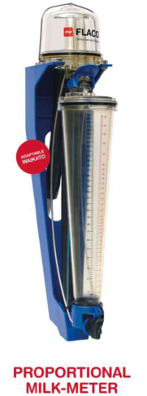
Unapproved DHI Meters - Flaco
Imitation Waikato meter manufactured in China
Not ICAR approved
Accuracy and parts quality questionable

Slide 36
Meter Repair Tags
Space for Tester Name, Date & Problem
Quick ID of the problem
Reduces down time
Trace back and accountability

Slide 37
Meter Storage and Transport

Slide 38
Meter Storage
Plastic totes provide convenient storage
of up to 10 meters

Slide 39
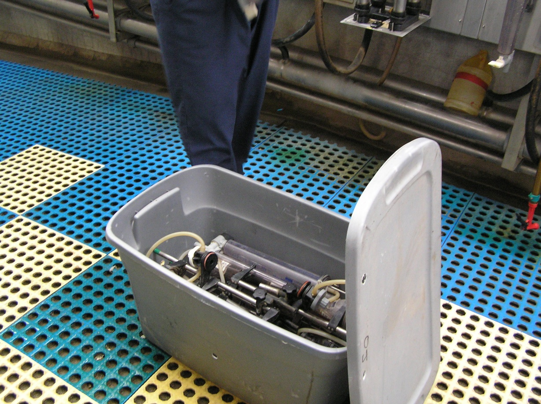
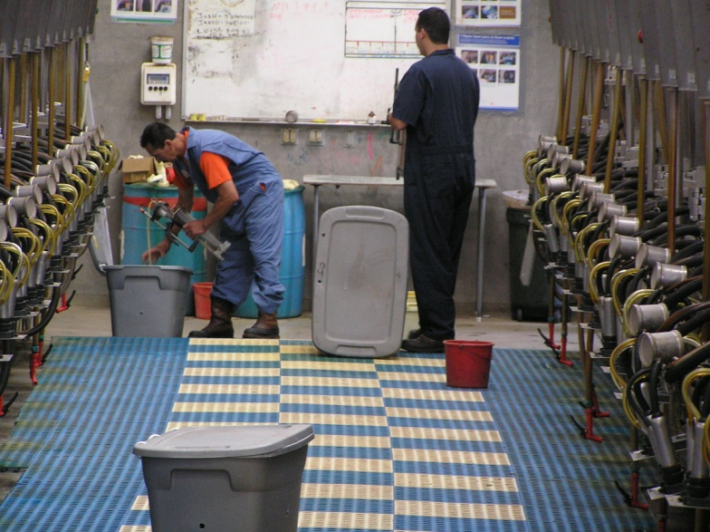
Meter Storage & Transportation
Totes are easily carried into milk barn for setup
Totes cost approximately $10-$12
One replacement meter costs approximately $400

Slide 40
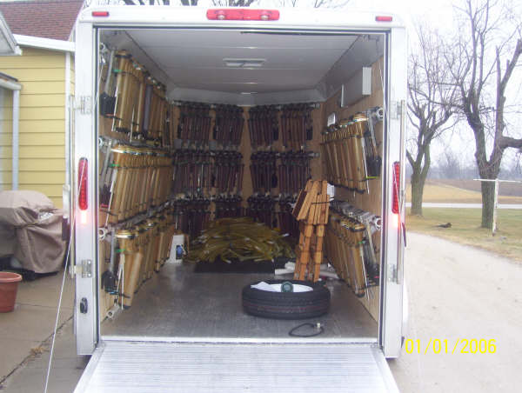
Meter Storage & Transportation
Truck bed cover keeps everything secure
Truck cover=$900
30 stolen meters=$10,500
Trailer transport for large herds

Slide 41
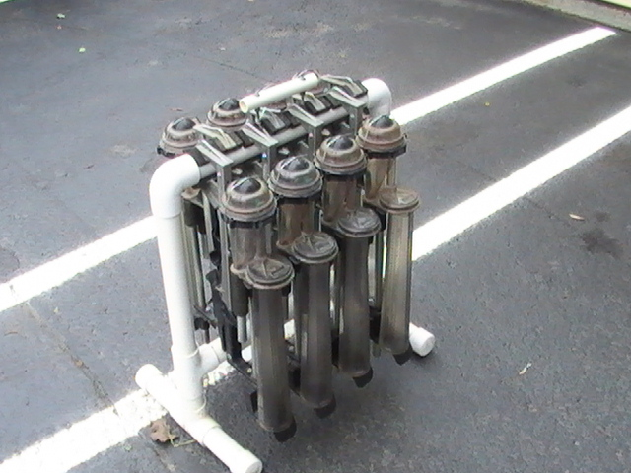
Meter Storage & Transportation
PVC pipe racks
Holds 8 meters with Super Clamps
Plans in Meter Technician Manual

Slide 42
Meter Storage & Transportation
PVC pipe racks
Holds 10 meters with Dovetail Brackets
Easy transport and minimal damage (if any)
Plans in Meter Technician Manual

Slide 43
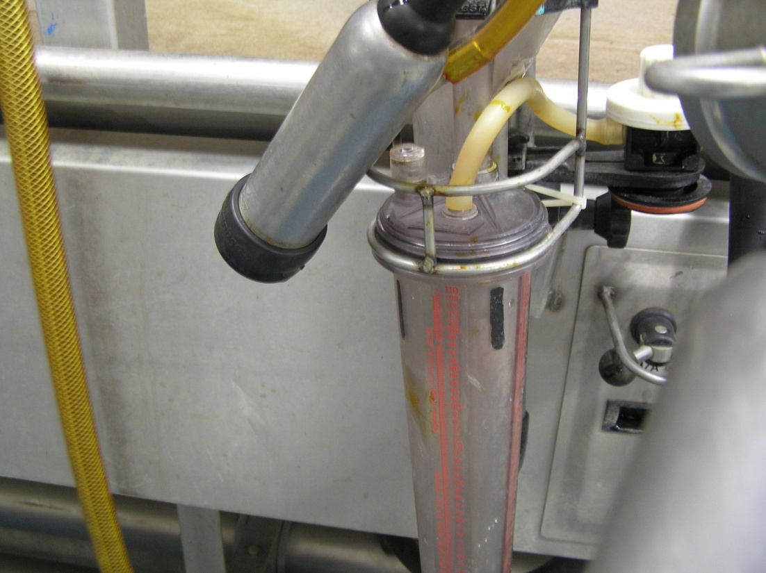
Meter Mask
Protects against meter body damage from teat cups and premature meter draining
Meter Mask= $20.00
Meter Body=$190.00

Slide 44
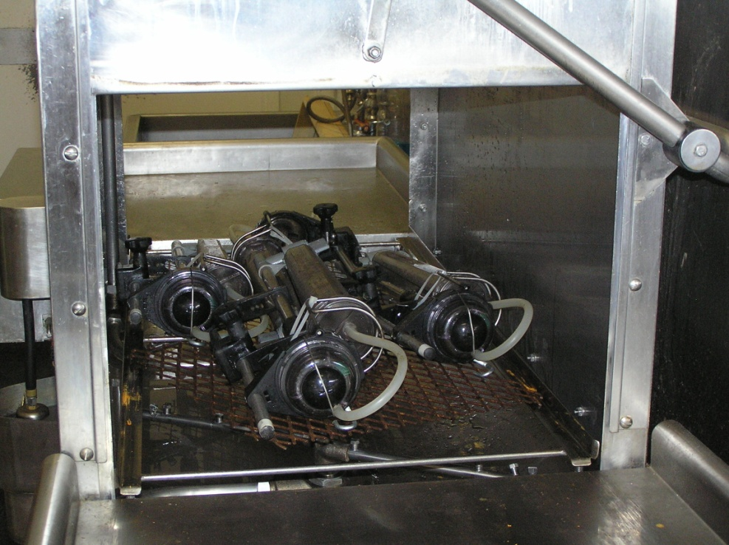
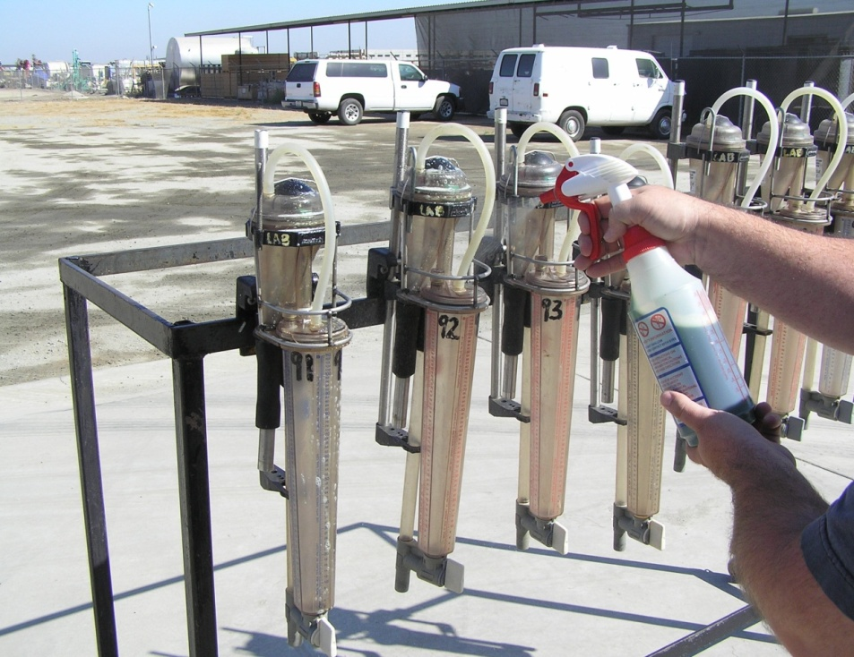
Heavy Duty Meter Cleaning

Slide 45
Proper Sampling and Reading

Slide 46
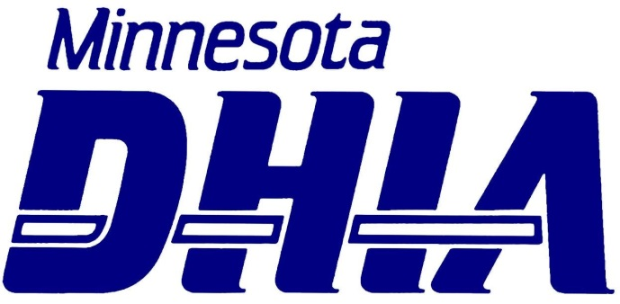
Sample Mixing Research
Minnesota DHIA Trial
Used Tru-Test Pull-Out meters with 68# & 102# meters
Removed flasks during milking, mixing thirds before sampling
Simply poured milk without mixing

Slide 47
58# milk in 102# Tru-Test Pullout Meter poured without mixing

Slide 48
51# of milk in 68# Tru-Test Pullout Meter

Slide 49
65# milk in 102# Tru-Test Pullout Meter

Slide 50
37# of milk in 68# Tru-Test Meter

Slide 51
Findings on Sample Mixing
Employ proper mixing of flask milk for every cow
Pull-Out Flasks – minimum of 2x (4x recommended)
Ezi-Test Meters – 10 seconds if flask is more than ½ full
Ezi-Test Meters – 5 seconds if flask is less than ½ full
Waikato Meters – 10 seconds
May need to be twice as long in cold weather/cold parlors
Fill sample vials immediately and shake to disperse preservative
DHIA laboratories have protocols in place for sample handling and mixing before analysis

Slide 52
Reading the Flask Volume
Read the BOTTOM of the meniscus
Foam does NOT count
Read between the lines
1 lb marks – read to ½ lb
½ lb marks – read to ¼ lb
Consistent reading from start to finish
Replace worn flasks

Slide 53
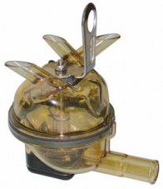
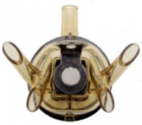
Test Day/Milk Shipped Deviations < 96%
Does the milking cluster have an effect?
Reports of challenges with FloStar claws
Claw is designed to encourage milk pooling and empties in a ‘sump pump’ fashion
There is a not a steady milk flow to portable volumetric meters
DHI meters read about 3-5% lower than on-farm fill-and-dump meters (Perfection) on total milk yield.

Slide 54
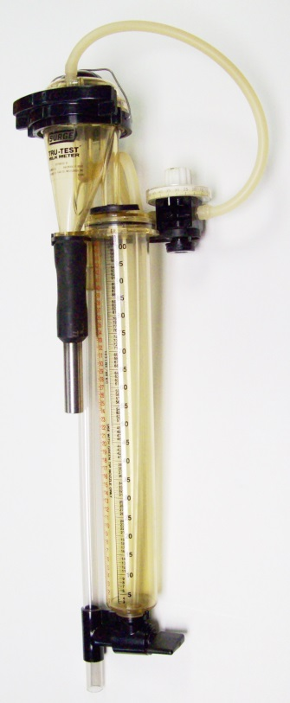
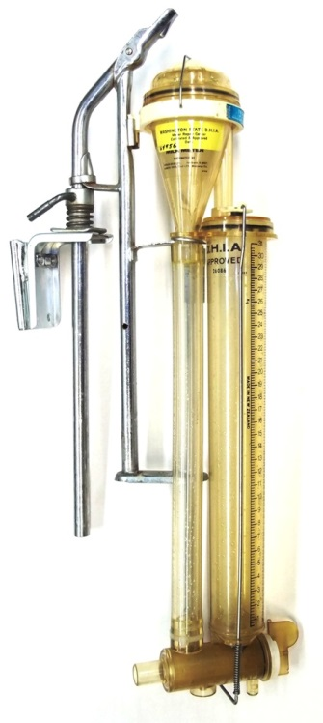
Test Day/Milk Shipped Deviations < 96%
Older Standard Bore Tru-Test meters & Waikato meters accurately proportion milk at flow rates up to 24 lbs/minute
May be underestimating milk yield during peak flow rates – possibly 3-5% of total milk yield
Need to use the right equipment for the job
Wide Bore (WB) meters accurately proportion milk at flow rates up to 32 lbs/minute
How well do they wash/clean?

Slide 55
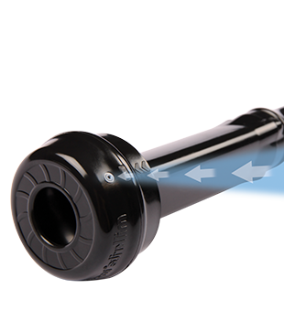
Test Day/Milk Shipped Deviations > 110%
Use of Milkrite impulseAir, Lauren, or Conewango vented inflations
Changes the milk-air ratio in the cluster/milk line – exceeds the ISO standard for air flow of 30 liters per minute
Tru-Test meters (all ICAR certified meters) are tested and approved to operate within ISO tolerances for air flow
Tru-Test WB meters may read 6-10% high (usually around 7-8%)

Slide 56
Testing for Potential Effect of Vented Inflations
The ICAR Recording and Sampling Devices SC (RSD-SC) met in February 2017
Similar concerns from Canada, UK, Denmark, Germany, Poland, France and Netherlands regarding vented inflations
Manufacturers slow to comment as these inflations are non OEM equipment
RSD-SC is planning a test of effect of vented inflations on milk meters
5 classes of meters
3 milk flow rates (3, 6, & 9 kg/minute)
9 air admission rates (including 3 that exceed ISO specifications

Slide 57
Some Final Thoughts on Meters
EQUIPMENT PERFORMANCE
FIELD TECHNICIAN PERFORMANCE
Start with clean, sanitized meters
Minimize hose length
Reduce vacuum loss
May have to have different hoses for different dairies
Clean the outside as well as the inside
CIP is NOT enough!
Protect meters – wax, etc.
Service and repair meters often
Share what is going on!
Replace VSO & gaskets
Read the meters properly without any influence from dairy owner
Use proper sampling and mixing techniques

Slide 58
Your Challenge is…
You control your image…
Professional appearance
Properly operating equipment
Proper technique
Exceed the minimum requirements
Communicate your needs with management
Resulting in…
Accurate and consistent results
Fewer concerns and/or complaints from dairymen
Customer retention and satisfaction

Slide 59
Quality Certification Services Inc.
Performance & Quality Standards
Compliance Auditing of Providers
Education, Training, & Development
A simple, yet vital mission….
Providing a reliable source of information to people interested in the U.S. dairy records industry.

